Slide 1


Effectuation
&
Entrepreneurial Style

Slide 2
Contents:
Effectuation:
    Meaning of Effectuation
    Features of Effectuation
    Principles of Effectuation
Entrepreneurial Style:
    Meaning of Entrepreneurial Styles
    Types of Entrepreneurial Styles
    Self Assessment Test

Slide 3
Meaning of Effectuation
“Saras Sarasvathy’s theory of Effectuation (2001) describes an approach to making decisions and performing actions in entrepreneurship processes, where you identify the next, best step by assessing the resources available in order to achieve your goals, while continuously balancing these goals with your resources and actions.”
Video of Wadhwani Foundation

Slide 4
Features of Effectuation
Face Challenges with Common Sense
Focus on what is doable
Framework to make Decisions
Mindset and Practical Approach
It is not a Formula
It not means that Entrepreneurs don’t Plan

Slide 5
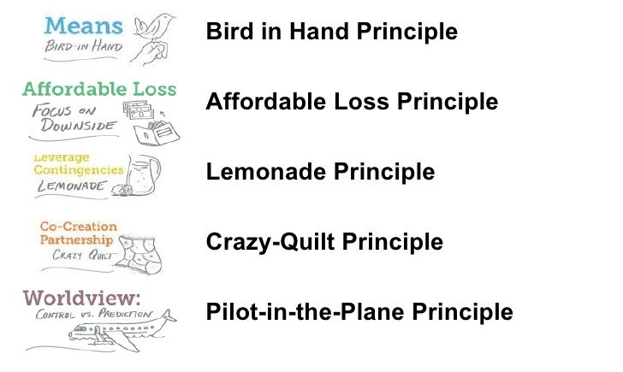
Principles of Effectuation:

Slide 6
Principles of Effectuation:
The Bird in Hand Principle: Entrepreneurs start with what they have.
The Affordable Loss Principle: How they can minimize those losses.
The Crazy Quilt Principle: Entrepreneurs cooperate with parties they can trust.
The Lemonade Principle: Entrepreneurs will look at how to leverage contingencies.
The Pilot-in-the-plane: Entrepreneurs can control some of the factors which determine the future.
Video of Wadhwani Foundation

Slide 7
Meaning of
Entrepreneurial Style:
Every entrepreneur is different and each one has his/her own style. If you are to indeed become an entrepreneur, you need to find out your potential entrepreneurship style.
        Video of Wadhwani Foundation

Slide 8
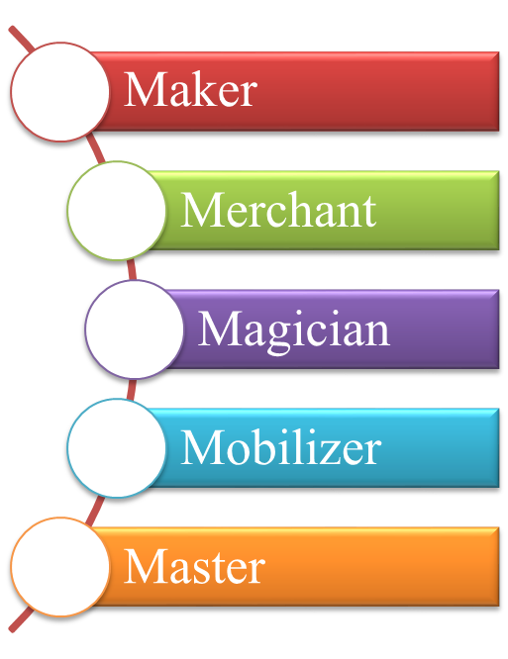
Different types of
Entrepreneurial Style:
    Maker
    Merchant
    Magician
    Mobilizer
    Master
Video of Wadhwani Foundation

Slide 9
Find Your
Entrepreneurial Style:
This activity will help you identify your entrepreneurship style and figure out the skill sets that you need in your partner or your team member to complement yours.
In this activity, your facilitator will help you understand the different entrepreneurial styles using the Wadhwani 5M Model. He/she will also help you score your quiz to get at your quiz result.
Video of Wadhwani Foundation

Slide 10
THANK YOU

